Slide 1
LSTM Neural Networks
And the future DIrection of deep learning

Slide 2
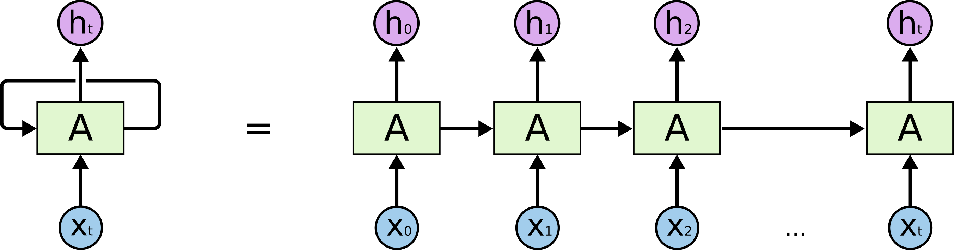
LSTM networks are a subset of RNNs
All LSTM networks employ the recurrent strategy, and share weights across time steps
A reminder of the RNN model, where Xt is the input at time t, A is the activation function, and Ht is the hidden layer value at time t:
The results of the activation function at time t-1 are taken into account in the computation of A at time t.

Slide 3
Why do RNNs share weights across time steps?
To a certain degree, this reduces precision, so why does it make for a better model?
Sharing weights allows for better generalization to new, similar data
This makes for better scores on test data
Weight variability makes for a much more exhaustive, “logical exact-match modeling capability
requiring a larger memory system containing all known sequences to match against” – Computer
Vision Metrics – Survey, Taxonomy, and Analysis of CV, Visual Neuroscience, and Deep Learning, by
Scott Krig
So, it is possible to create RNNs without using the same weights, but this is many orders of
magnitude more computationally expensive, and while very precise, still not as good at
generalizing to unseen data.

Slide 4

Why use LSTMs? How are they different?
Sentence Prediction: When RNNs are good enough, and when they aren’t
“I see clouds in the sky”
Here, RNNs might be good enough for predicting the word “sky”, since the distance between the
context ‘clouds’ and the predicted word is relatively small, and so is the difference between time
steps.
“I grew up in France, to a small family of lavender farmers; I speak fluent French.”
In this example, the difference in time steps between the predicted word ‘French’ and the
relevant contextual word ‘France’ is much larger, and by the time the algorithm gets to ‘fluent…’,
much of the information from the time step where the context was is lost.

Slide 5
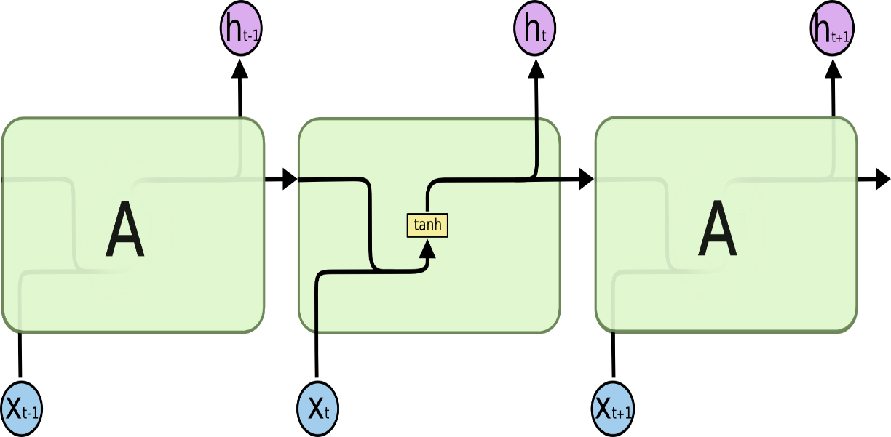

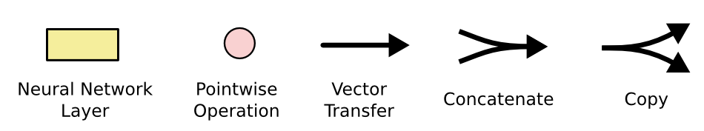
What does an LSTM net look like?
RNN, with hyperbolic tangent hidden layer initialization
LSTM, with gates and initialization functions

Slide 6
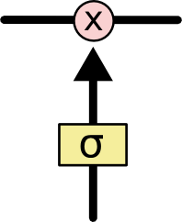
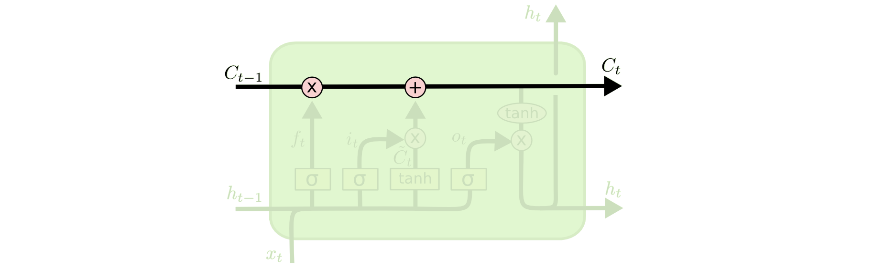
Gating and the core idea of LSTM
A sigmoid neural net layer output returns values between 0 and 1, as we remember.
In the case of LSTM, this first sigmoid layer determines, on a scale of 0-1, how much information should be let through this X gate. 0 -> nothing, 1-> everything
After passing through all the gates of all the network layers, the + refers to all the information that has been gated passing through

Slide 7
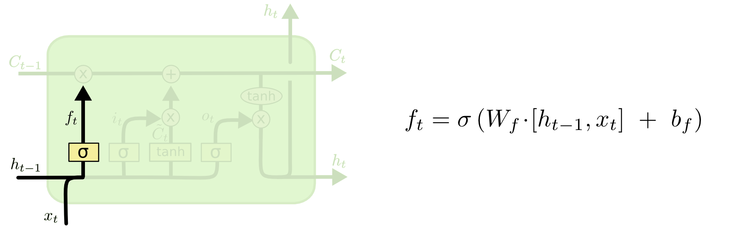
Step-by-step through LSTM gating (warning: Math)
1st step: simple sigmoid gating from 0 -> 1. Takes in weight * [hidden layer value at t-1, input at t] + b. Easy! Decides how much information to gate.

Slide 8
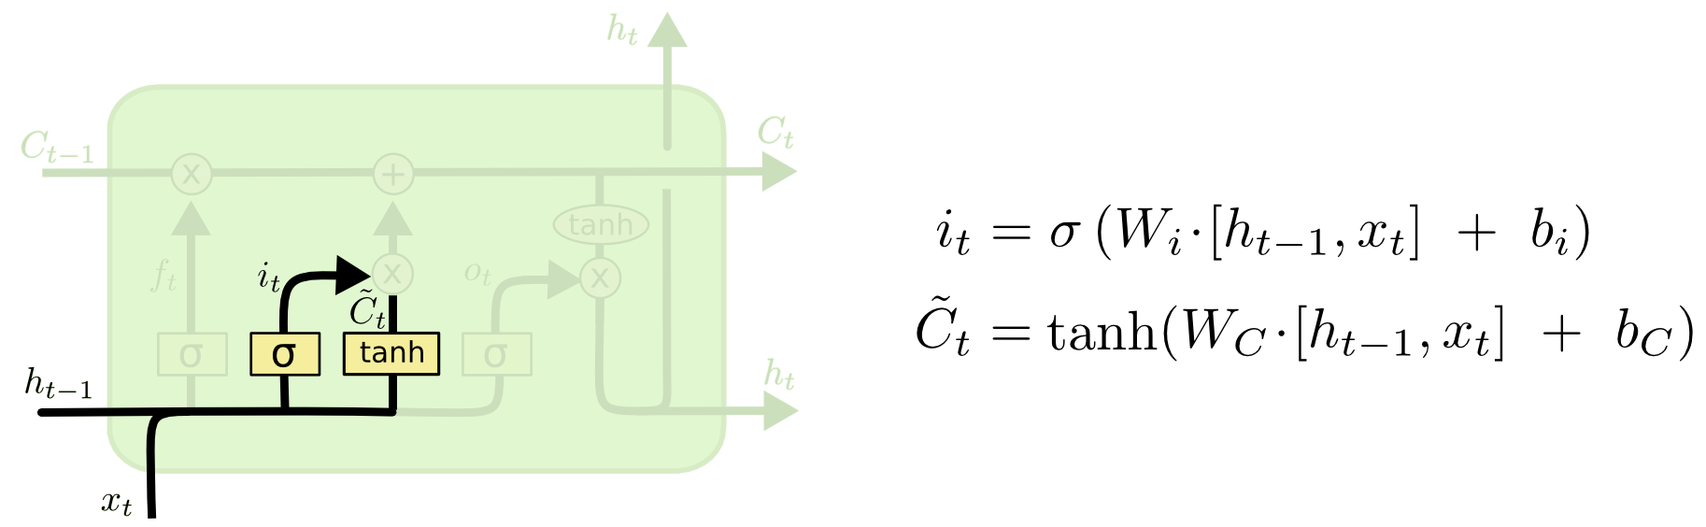
Step-by-step through LSTM gating
2nd step: Our sigmoid function from last step is multiplied with the regular RNN hyperbolic tangent activation function (range [-1,1]), to get only the portion of the current information we want, and forgetting that which we don’t.
Why would we want to forget information? Say each hidden layer value is a candidate. You do not want factors like the gender of the previous candidate to factor into the current candidate’s information.

Slide 9
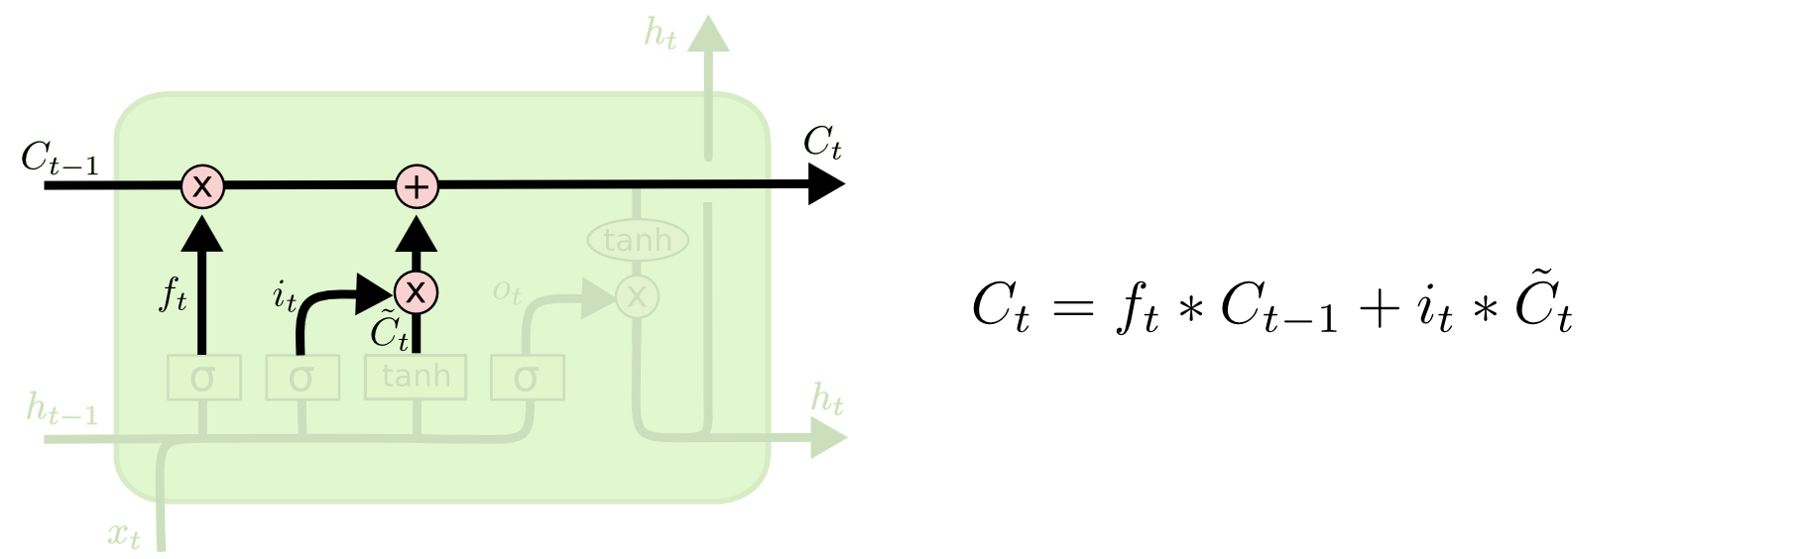
Step-by-step through LSTM gating
2nd step, part 2: reiterating what we know; C(t) as a function of previous time steps

Slide 10
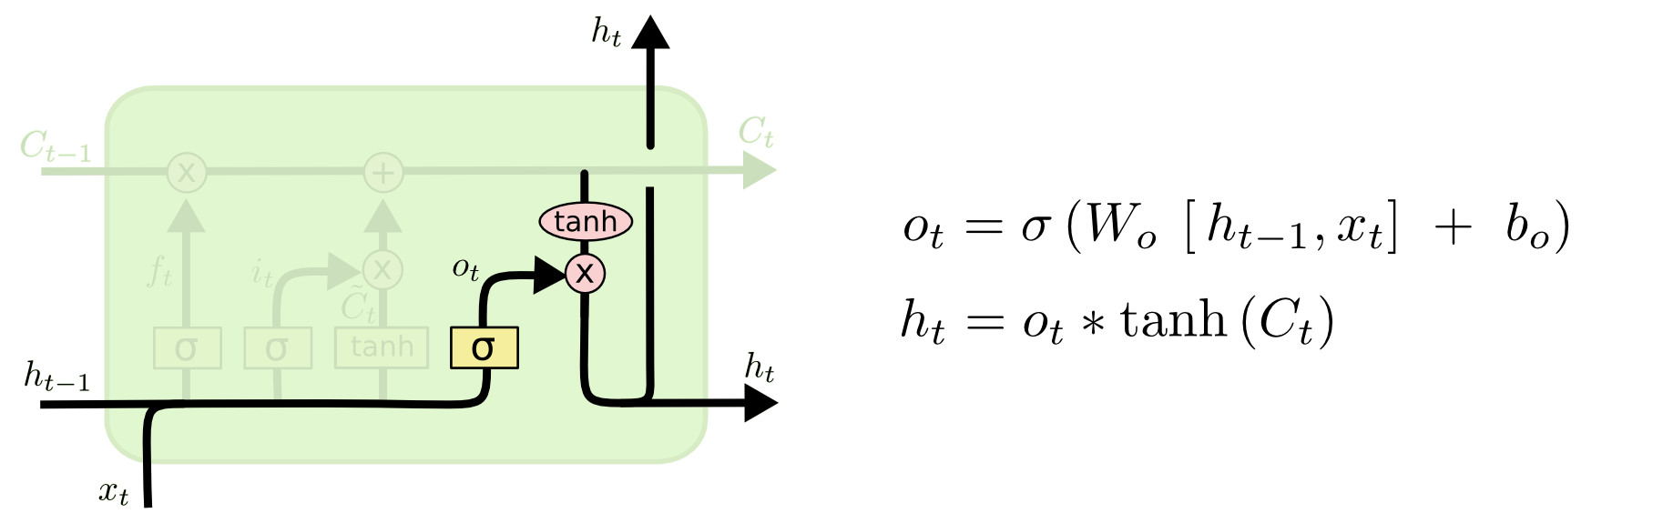
Step-by-step through LSTM gating
3rd and final step: We apply the same sigmoid-to-gate function as in step 1, and one more hyperbolic tangent function to the gated result. The final hidden value layer, Ht, is a function of this result, and the previous two gated functions. In total, we are applying sigmoid initializations to three of the four hidden layers in the time step. This is repeated for every step t.

Slide 11
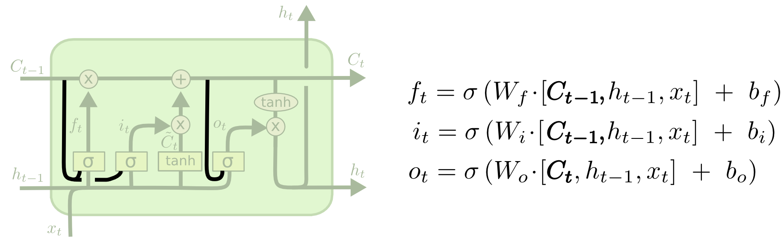
LSTM variations
Gers & Schmidhuber (2000), adding “peephole connections.” This means that we let the gate layers look at the cell state.

Slide 12
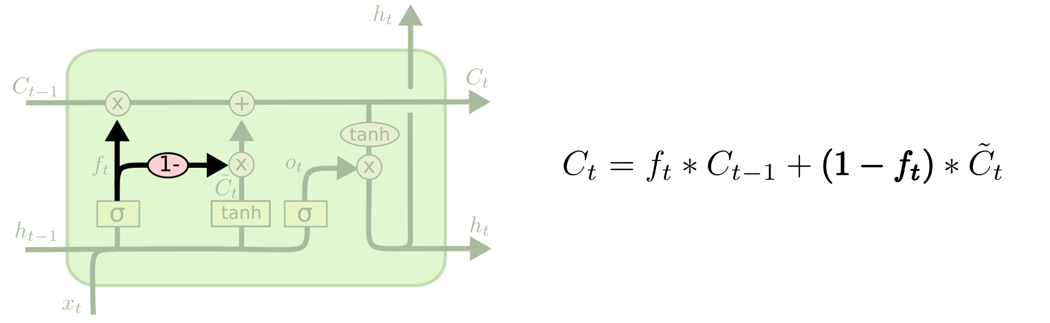
LSTM variations
Coupled forget and input gates. “Instead of separately deciding what to forget and what we should add new information to, we make those decisions together. We only forget when we’re going to input something in its place. We only input new values to the state when we forget something older.” - http://colah.github.io/posts/2015-08-Understanding-LSTMs/

Slide 13
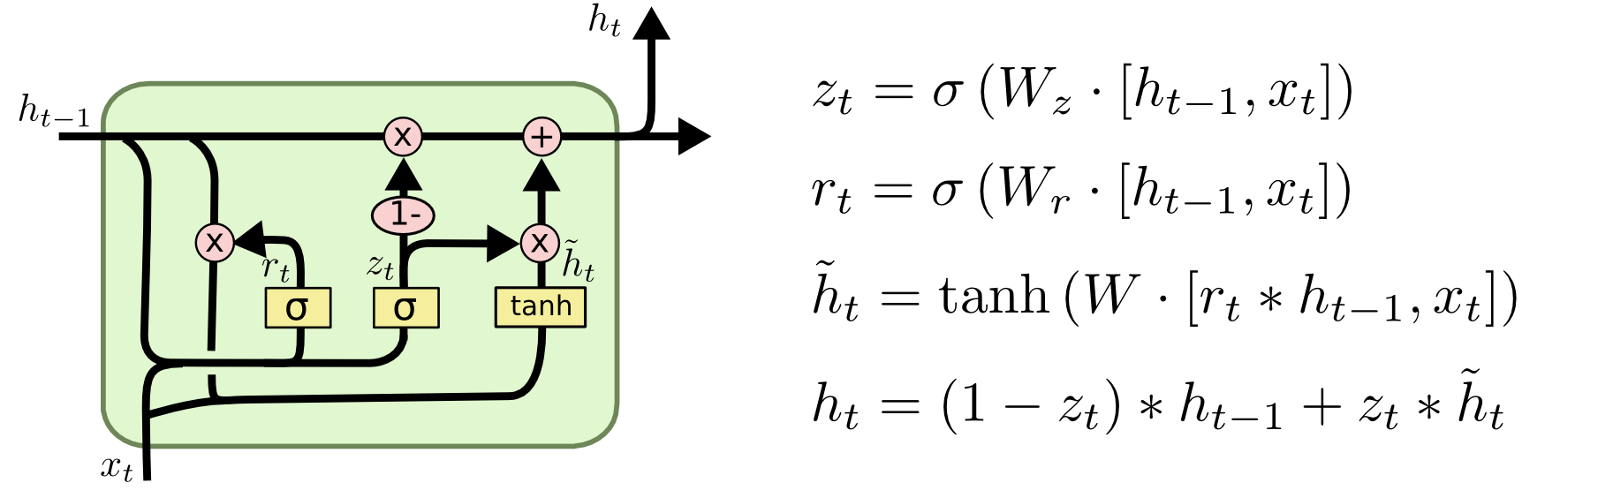
LSTM variations
Gated Recurrent Unit, or GRU, introduced by Cho, et al. (2014). It combines the forget and input gates into a single “update gate.” It also merges the cell state and hidden state. Simpler than most LSTM models currently used, and thus gaining popularity

Slide 14
Theory is cool, but we want (pseudo)code!
lstm = tf.contrib.rnn.BasicLSTMCell(lstm_size) # Initial state of the LSTM memory. state = tf.zeros([batch_size, lstm.state_size]) probabilities = [] loss = 0.0 for current_batch_of_words in words_in_dataset: # The value of state is updated after processing each batch of words. output, state = lstm(current_batch_of_words, state) # The LSTM output can be used to make next word predictions logits = tf.matmul(output, softmax_w) + softmax_b probabilities.append(tf.nn.softmax(logits)) loss += loss_function(probabilities, target_words)
A mini-batch approach to LSTMs in language models

Slide 15
Other cool applications
Music Generation
Uses LSTM model to output probabilities of midi notes in a sequence, based on the previous
notes.
Event-driven Time Series (EEG, EKG!)
LSTM models can learn from events that happened much farther back than the current point in
time, in comparison to RNN models. This is key to event-driven signals like EEG and EKG/ECG

Slide 16
What is the future of LSTM?
Attention-based LSTM models
The attending RNN/LSTM generates a query describing what it wants to focus on. Each item is dot-
producted with the query to produce a score, describing how well it matches the query. The scores are
fed into a softmax to create the attention distribution. The RNN ‘attends’ to different time steps thus
differently, according to the attention distribution (super cool!)
Using Reinforcement Learning to tune LSTM parameters
Reinforcement learning is a different area of ML than Deep Learning, but the two can and have
been used in conjunction, to great success.
RL is based on behavioral psychology, and is a way of optimizing agent-based models in such a
way to maximize reward. This is great for parameter tuning of Deep Learning algorithms.

